Slide 1

-
Analysing the Impact of Corruption on Food Security: A Study of the Relationship Between Corruption Index and Global Hunger Index (GHI) (SDG 2: Hunger & SGD: 16: Corruption) Predictive Modeling for sseverity of hunger (Rank_Class)
Data Analytics-IBM Internship

Slide 2
Introduction
The objective of this project is Analysing the Impact of Corruption on Food Security: A Study of the Relationship Between Corruption Index and Global Hunger Index (GHI) (SDG 2: Hunger & SGD: 16: Corruption) and predict the level of hunger severity based on the GHI ranging. The two datasets consist of predictors (Independent) variables and one target variable that we got when we "Rank_in_2022" variable will converted the ranks into classes (e.g., low: Well-nourished countries, medium: Moderately nourished countries, high: Severely nourished countries), (Rank_Class). Predictor variables include Corruption Index, Annual Income, Year_2000, Year_2007, Year_2014, Year_2022, and Rank_Class.

Slide 3
Setup and Initialization
We imported all the libraries and utilities I needed for the project such as matplotlib, numpy, seaborn, sklearn for preprocessing the data, machine learning algorithms and matrices for evaluations
We also loaded the two datasets ie the CSV files that we got from Kaggle for the project

Slide 4
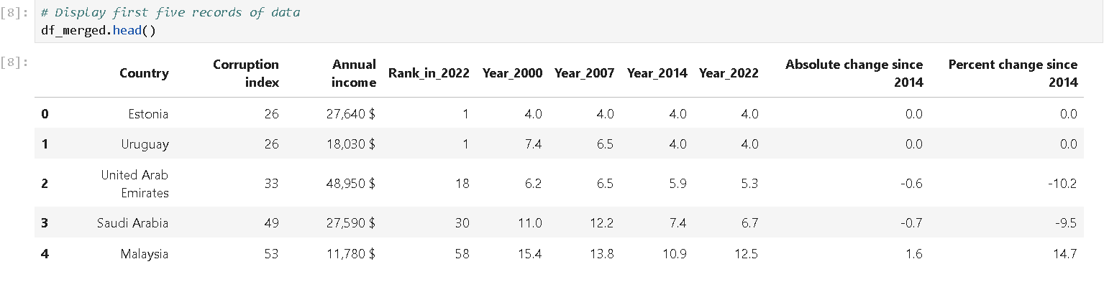
Data Preprocessing
Data preprocessing is a data mining technique that transforms raw data into an understandable format. This process has four main stages – data cleaning, data integration, data transformation, and data reduction
In the data cleaning process, we tired to filtered, detects, and handle noises, checked for outliers, duplicates, and missing values to ensure quality data and quality analysis results.

Slide 5
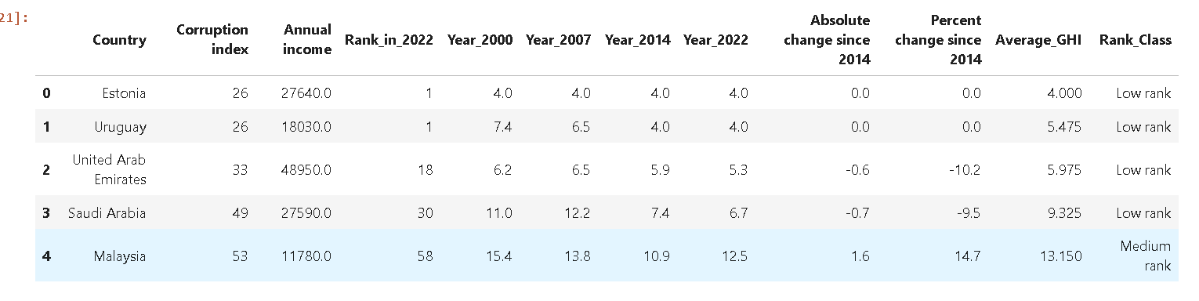
Cont…
We transformed the “Rank_in_2022” column to a categorical levels: low (0): Well-nourished countries, medium (1): Moderately nourished countries, high (2): Severely nourished countries

Slide 6
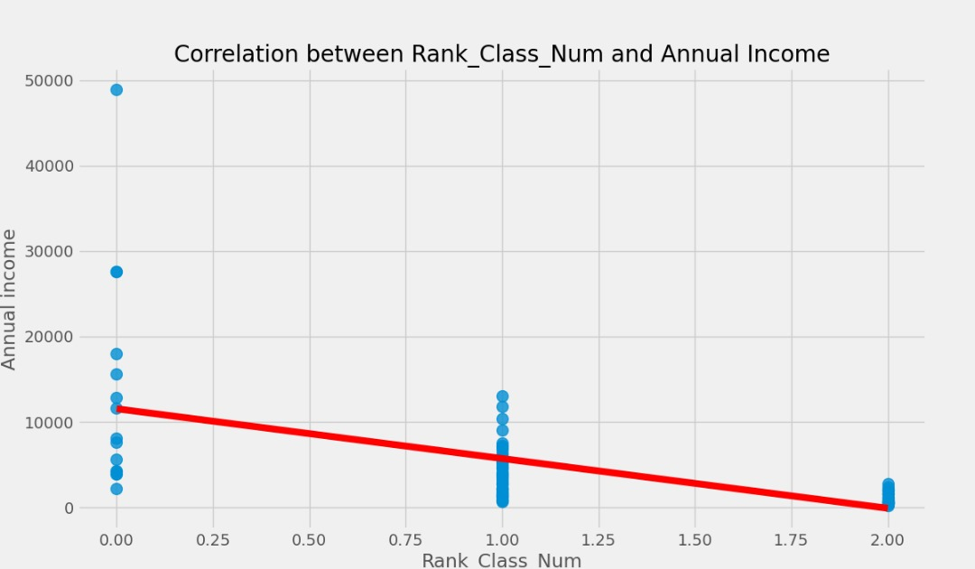
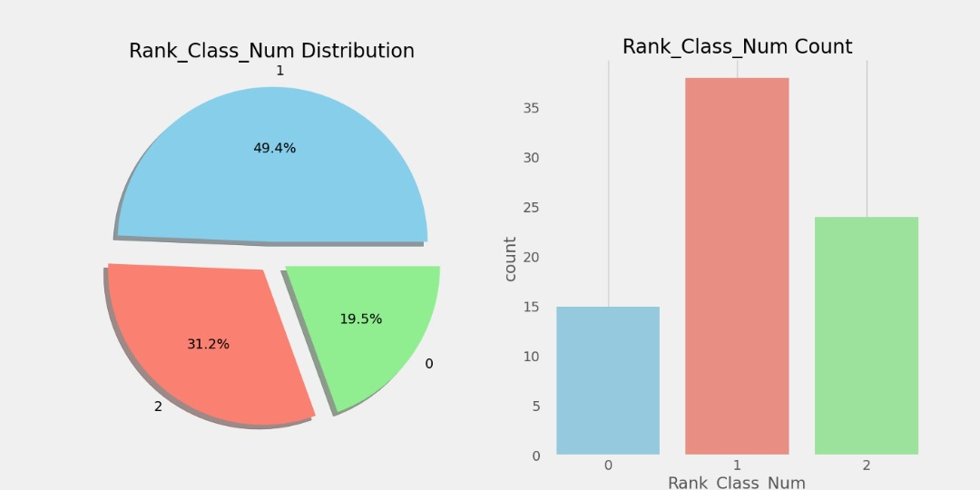
Exploratory Data Analysis (EDA)
Out of total 77, 15 (Low Rank:0) are Well-nourished countries, 24 (Medium Rank:1) are Moderately nourished countries and 38 (High Rank:2) are Severely nourished countries.- countries are more than Well-nourished countries

Slide 7
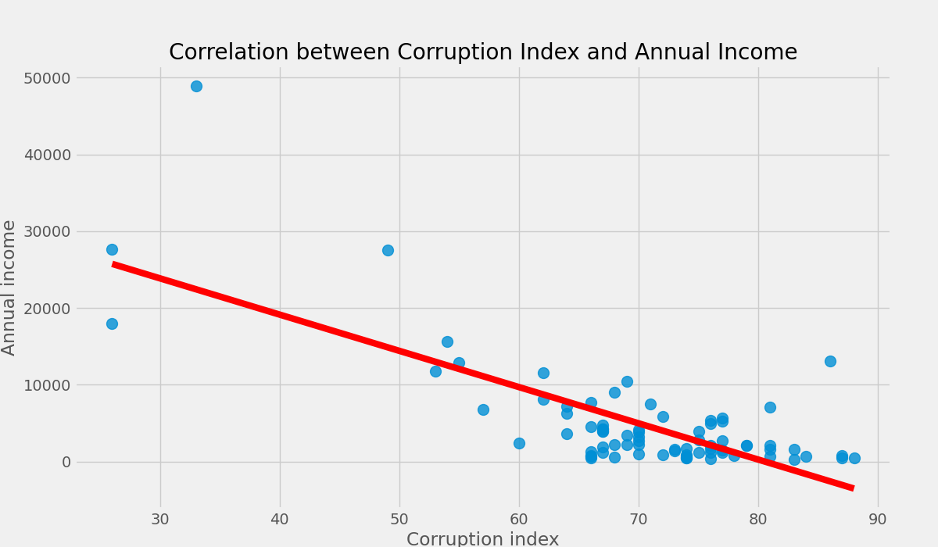
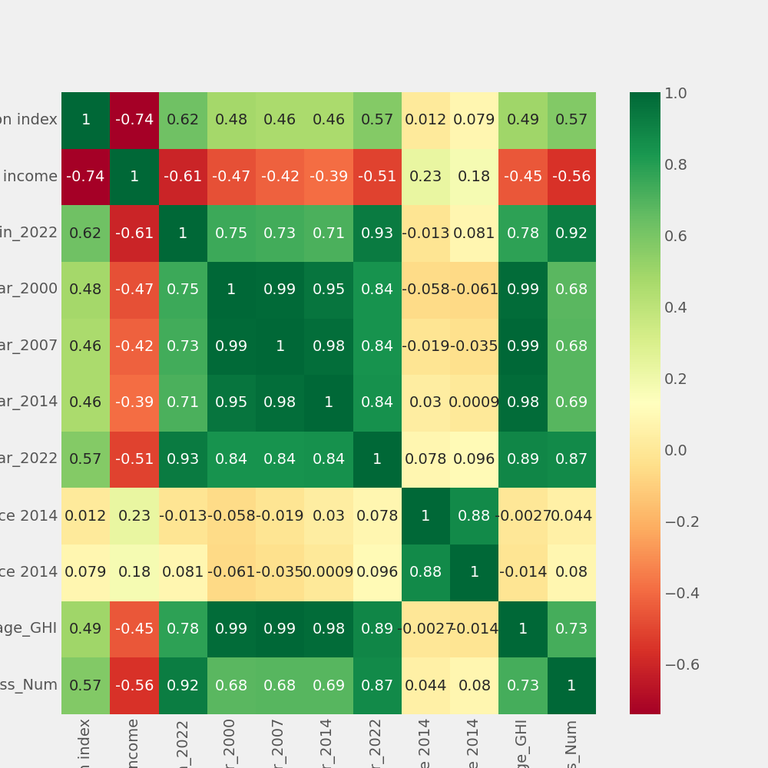
Exploratory Data Analysis (EDA)
This value indicates a strong negative linear relationship between the two variables.
The corruption index of a country increases (indicating higher corruption), its average annual income tends to decrease, and vice versa.

Slide 8
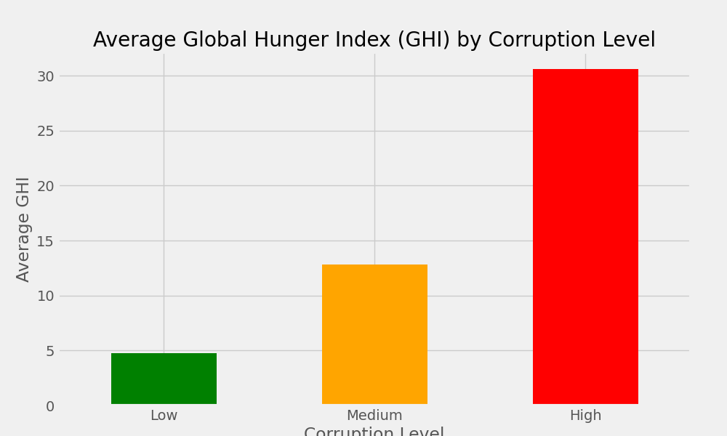
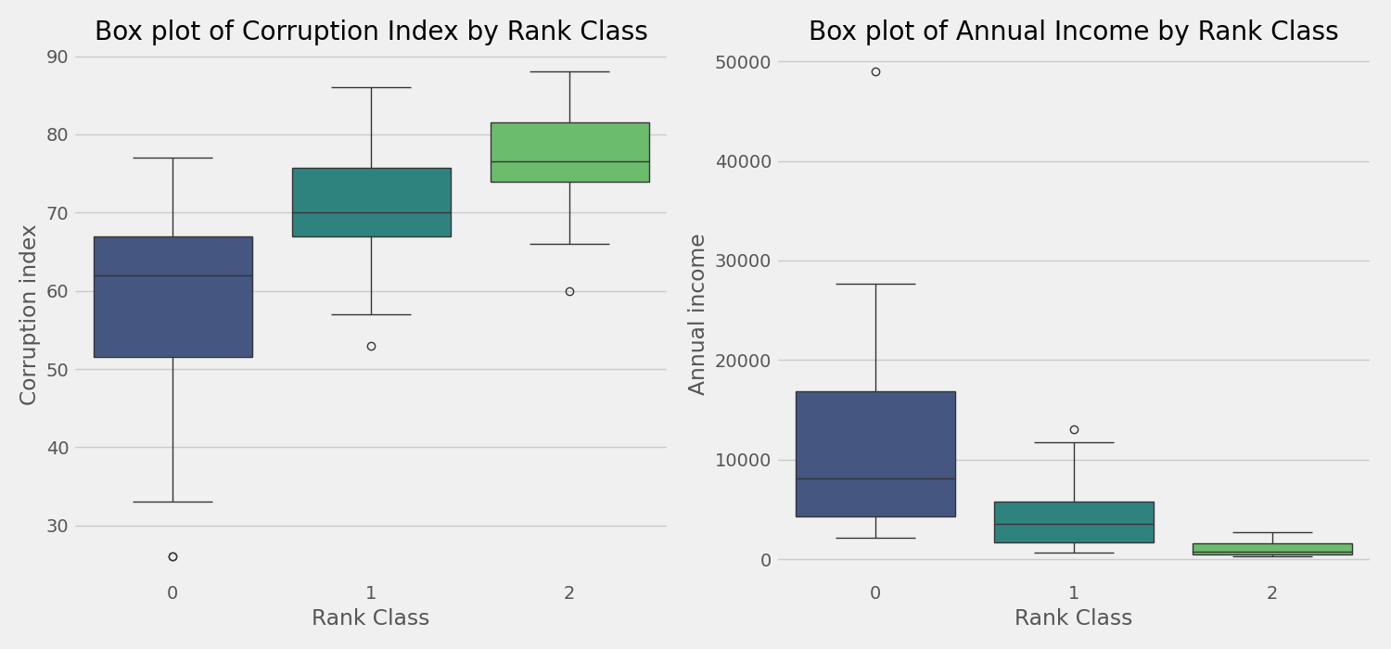
Exploratory Data Analysis (EDA)
Frome the bar chart above we can see that countries with higher corruption tend to have worse hunger indices
Rank Class 0: "moderate Corruption, moderate Income“, Rank Class 1: "High Corruption, Low Income"- Rank Class 2: " very High Corruption, very low Income“, from the boxplot

Slide 9
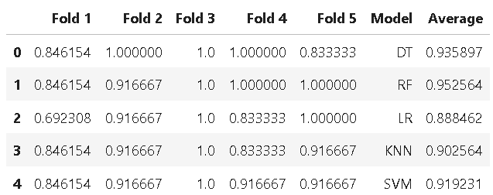
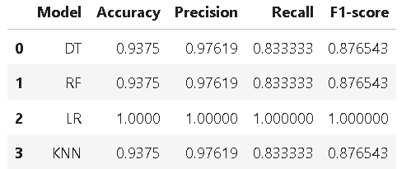
Machine Learning Models
The following machine Learning algorithms are chosen to fit to the datasets. These models should be classifiers for multi-class classification.
Decision Tree (DT)
Logistic Regression (LR)
Random Forest (RF)
Support Vector Machine (SVM)
KNeighborsClassifier (KNN)

Slide 10
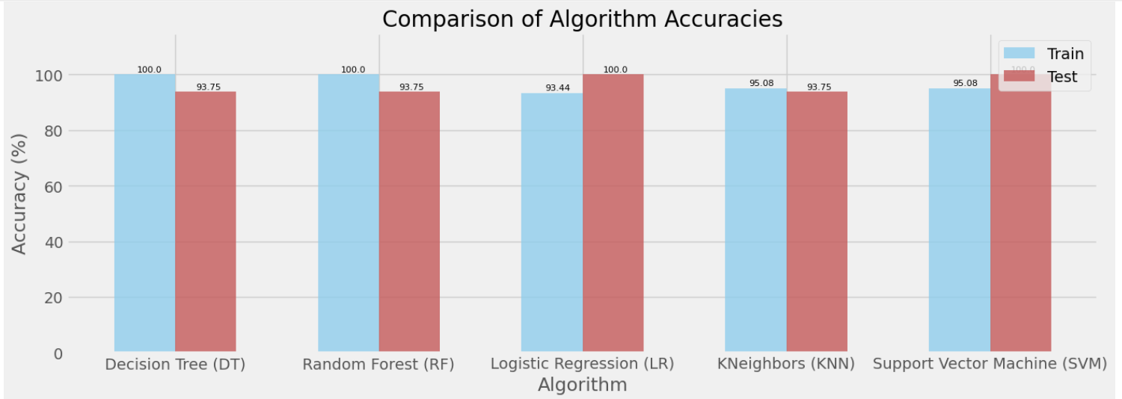
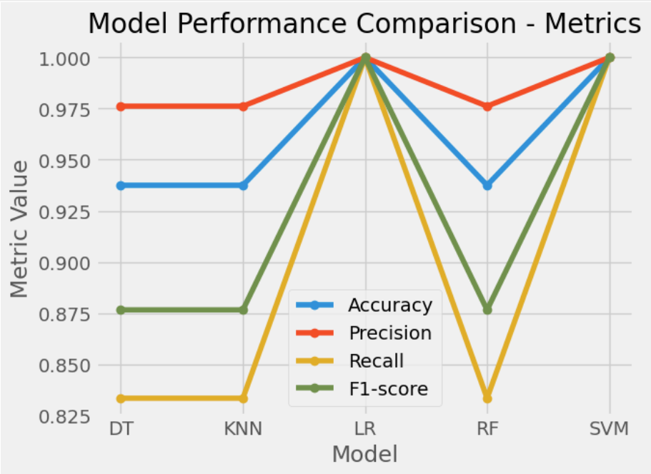
Cont.
Logistic Regression (LR) and SVM seems to perform the best overall due to its balanced precision and recall
Logistic Regression (LR) and SVM has the best performance for both the training and test accuracy

Slide 11
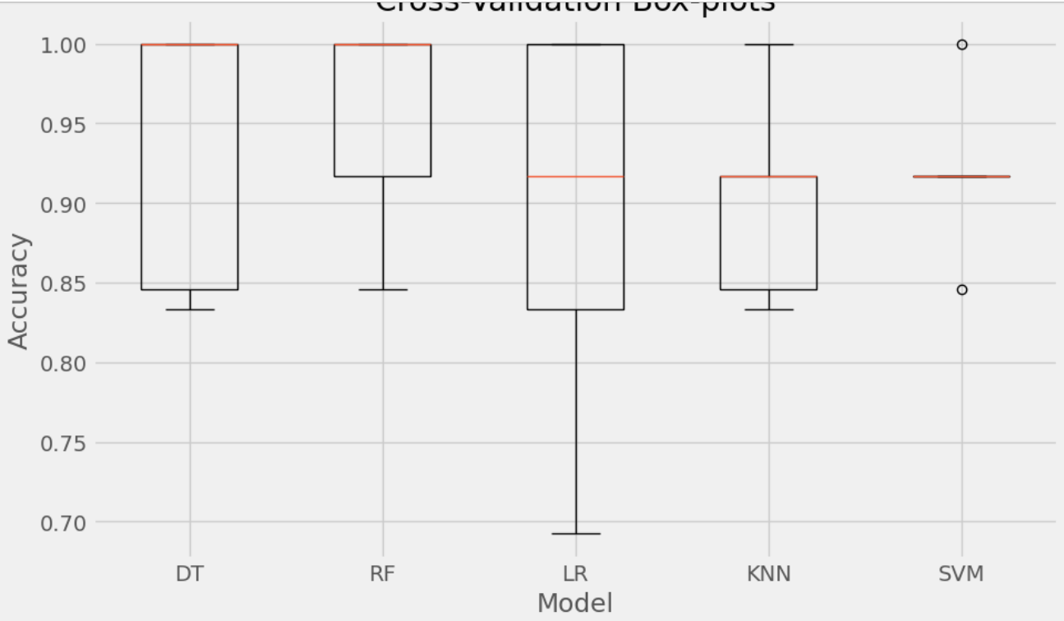
Comaprision of Models Using Cross-Validation Scores
After CV each model achieved perfect performance on each fold. This is indicated by a score of 1.0 for each fold and an average score of 1.0.
All models have consistently achieved a score of 1.0 across all folds except that Rf and DT, indicating very high or perfect performance.

Slide 12
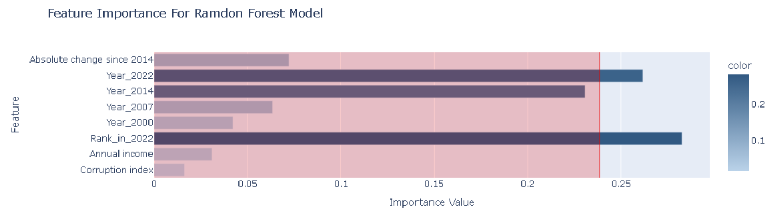
Model Interpretation
Class1
Class1
Class1
The final crucial step of a data science project is the interpretation of the models and data, in terms of its predictive power and thus its ability to generalise unseen future data
Predicted class label:
[‘Class1’: 1] ie (Medium Rank:1); Moderately nourished countries

Slide 13
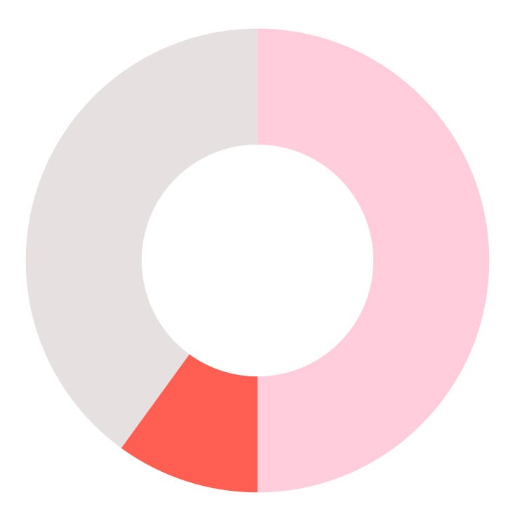
Analysis of Results (Classification)
1st Most Stable
Random Forest
2nd Most Stable
Decision Tree
3rd Most Stable
Logistic Regression
least reliable
Support Vector Machine
KNN
least reliable

Slide 14
THANKS!
Q&A

